Slide 1

Multiple Disease Prediction System

Slide 2


Problem Statement
Many of the existing machine learning models for health care analysis are concentrating on one disease per analysis. For example first is for Diabetes analysis, one for Heart analysis, one for Lung diseases like that. If a user wants to predict more than one disease, he/she has to go through different sites. There is no common system where one analysis can perform more than one disease prediction. Some of the models have lower accuracy which can seriously affect patients’ health.

Slide 3

About the project
This Web App is developed using Python’s Streamlit library
The models used to Predict the diseases were trained on large Datasets.
The web-app can predict following Diseases:
Diabetes Disease
Heart Disease
Parkinson Disease

Slide 4
Streamlit Library : Streamlit is an open source app framework in Python language. It helps us create web apps for data science and machine learning in a short time. It is compatible with major Python libraries such as scikit-learn, Keras, PyTorch, NumPy, Pandas, Matplotlib etc. Streamlit is a free and open-source framework to rapidly build and share beautiful machine learning and data science web apps. It is a Python-based library specifically designed for machine learning engineers.

Slide 5
Procedure : • Import the necessary libraries and the datasets • Split the data into features and target variables • Split the data into training and testing sets • Train the model on the training data • Save the model using the pickle module • Use Streamlit to create a web application that allows users to input their own data and make predictions using the saved model • Include a button in the application to process the user input and make predictions

Slide 6
Algorithms used :- 1) SVM – Support Vector Machine : Support Vector Machine or SVM is one of the most popular Supervised Learning algorithms, which is used for Classification as well as Regression problems. The goal of the SVM algorithm is to create the best line or decision boundary that can segregate n-dimensional space into classes so that we can easily put the new data point in the correct category in the future. 2) Logistic Regression : Logistic regression is one of the most popular Machine Learning algorithms, which comes under the Supervised Learning technique. It is used for predicting the categorical dependent variable using a given set of independent variables. Logistic Regression is a significant machine learning algorithm because it has the ability to provide probabilities and classify new data using continuous and discrete datasets.

Slide 7
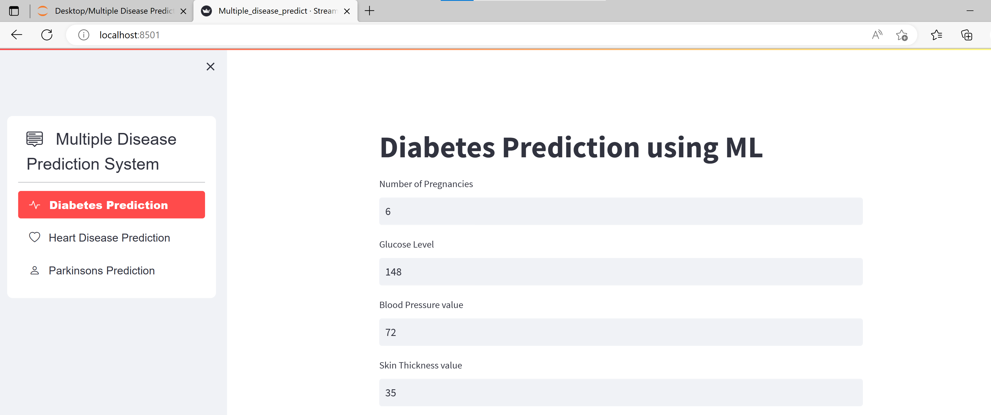
Implementation :

Slide 8
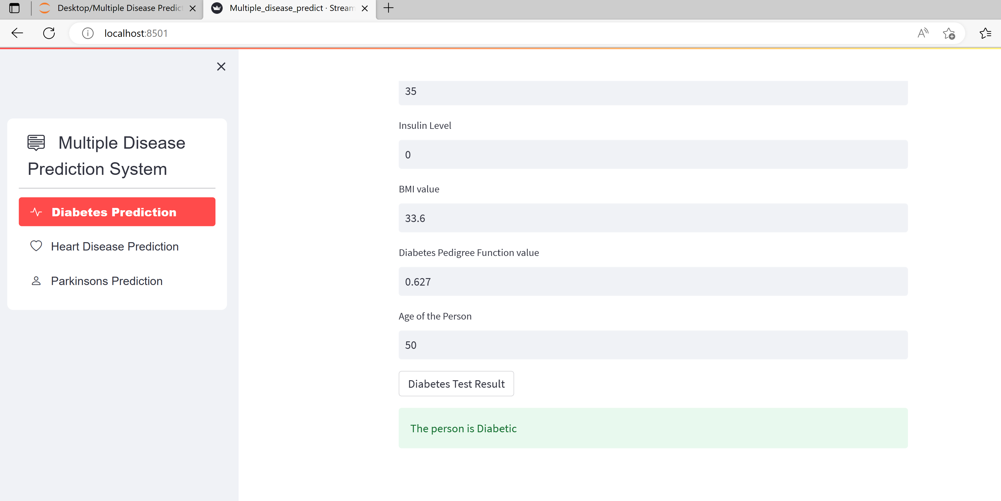

Slide 9

Application
With the advancement in technologies and mobile phones being the most used user-friendly device, an application that provides a prediction of the most caused lifestyle diseases like diabetes, heart disease, and other diseases. Disease predictor allows you to make important predictions about an ongoing but unknown disease with a few pieces of information like symptoms and diagnostic reports. It also helps you to have an in-depth knowledge of the symptoms, causes, and other important factors for future reference.

Slide 10
Thank You

